Slide 1
Software Design and Architecture
Bridge and Mediator Patterns

Slide 2
Design principles
High-level principles
‣ Single Responsibility
‣ Open/Closed
‣ Liskov Substitution Principle
‣ Interface Segregation
‣ Dependency Inversion
Low-level principles
‣ Encapsulate what varies
‣ Program to interfaces, not implementations
‣ Favor composition over inheritance
‣ Strive for loose coupling

Slide 3
Bridge
Behavioral Patterns
observer
strategy
command
template
null object
state
iterator
Creational Patterns
factory method
abstract factory
singleton
Structural Patterns
decorator
adapter
façade
composite
bridge

Slide 4
Problem
"Hardening of the software arteries" has occurred by using subclassing of an abstract base class to provide alternative implementations.
This locks in compile-time binding between interface and implementation.
The abstraction and implementation cannot be independently extended or composed.

Slide 5
Bottom-Up Design
Let a set of shapes draw themselves using different drawing libraries
Think of the libraries as items such as Monitor, Printer, OffScreenBuffer, etc.
Imagine a world where each of these might have slightly different methods and method signatures

Slide 6
Examples of Drawing Library
•
The drawing library for Monitor has these methods
• draw_a_line(x1, y1, x2, y2)
• draw_a_circle(x, y, r)
• The drawing library for Printer has these methods
• drawline(x1, x2, y1, y2)
• drawcircle(x, y, r)

Slide 7
Examples of Shape
We want to be able to create collections of rectangles and circles and then tell the collection to draw itself and have it work regardless of the medium.

Slide 9
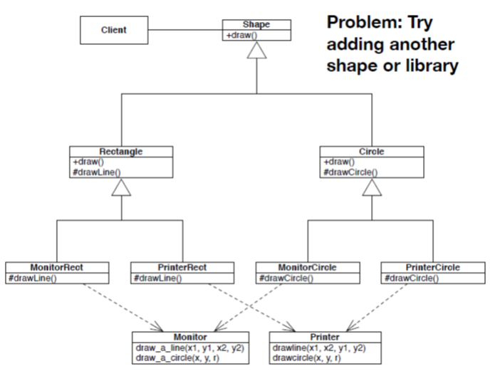

Slide 10
Class Explosion Problem
• We are using inheritance to specialize for implementation
• And, we encounter the combinatorial subclass program once again
2 shapes, 2 libraries: 4 subclasses
3 shapes, 3 libraries: 9 subclasses
100 shapes, 10 libraries: 1000 subclasses
• Not good!

Slide 11
Design Problem of Approach One
• Redundancy (duplication)
• Each subclass method is VERY similar
• Tight Coupling
Each subclass highly dependent on the drawing libraries
change a library, change a lot of subclasses
• Strong Cohesion?
Not completely, shapes need to know about their drawing libraries; no single location for drawing

Slide 12
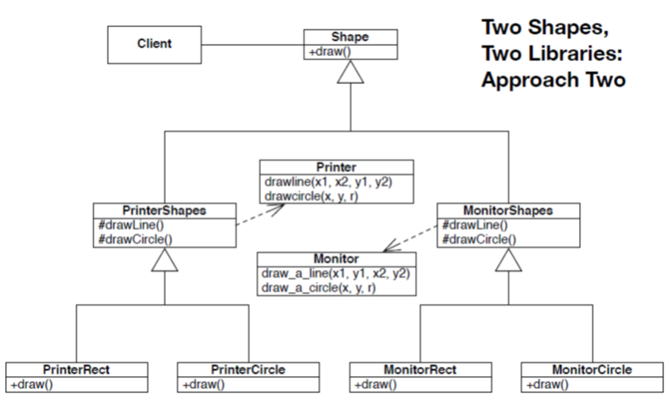

Slide 13
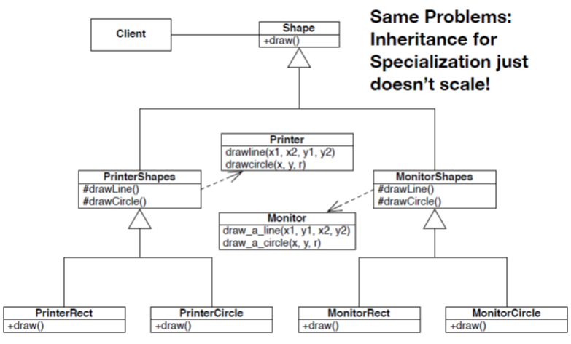

Slide 14
Encapsulate what varies?

Slide 15
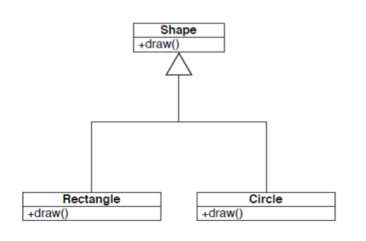
What varies? Shapes

Slide 16
What varies? Drawing Libraries
One abstract service which defines a uniform interface
The next level down consists of classes that wrap each library
behind the uniform interface

Slide 17
Favor Delegation
Two choices
• DrawingLibrary delegates to Shape
That doesn’t sound right
• Shape delegates to DrawingLibrary
That sounds better

Slide 18
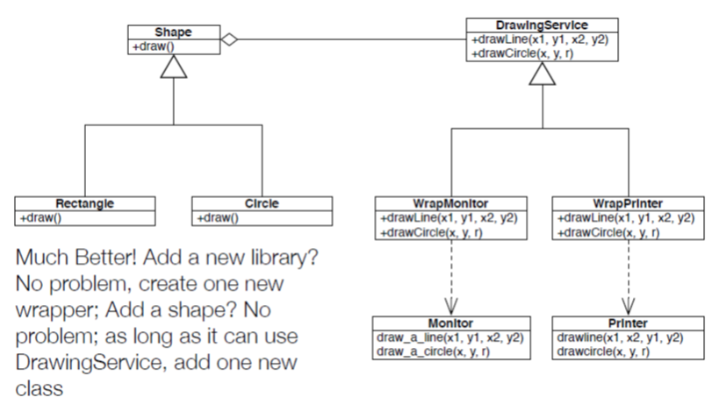

Slide 19
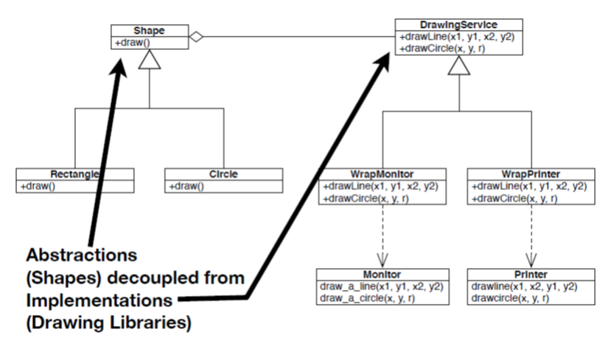

Slide 20
Bridge Pattern
The Bridge Pattern
Allows you to “decouple an abstraction
from its implementation so that the two can vary independently”.
Allows a set of abstract objects to implement their operations in a number of ways in a scalable fashion.

Slide 21
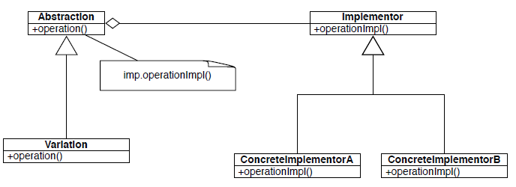
Class Diagram

Slide 22
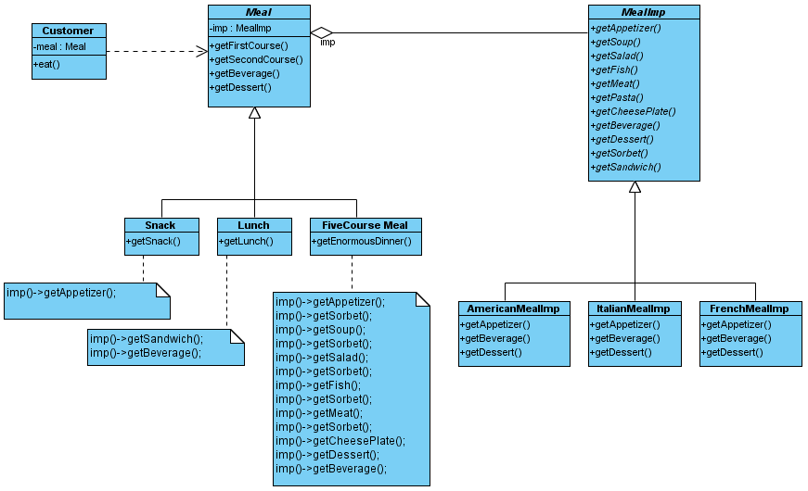
A Meal Example
bridge

Slide 23
Code – 1 of 1 (Abstraction)
public class Meal {
protected MealImp imp;
public Meal() {
imp = new AmericanMealImp();
}
public Meal(String type) {
if (type.equals("American"))
imp = new AmericanMealImp();
if (type.equals("Italian"))
imp = new ItalianMealImp();
if (type.equals("French"))
imp = new FrenchMealImp();
}
public void getFirstCourse() {
imp.getAppetizer();
}
public void getSecondCourse() {
imp.getMeat();
}
public void getBeverage() {
imp.getBeverage();
}
public void getDessert() {
imp.getDessert();
}
}
public class Snack extends Meal {
public void getSnack() {
imp.getAppetizer();
}
}
public class Lunch extends Meal {
public void getLunch() {
imp.getSandwich();
imp.getBeverage();
}
}
public class FiveCourseMeal extends Meal {
public void getEnormousDinner() {
imp.getAppetizer();
imp.getSorbet();
imp.getSoup();
imp.getSorbet();
imp.getSalad();
imp.getSorbet();
imp.getFish();
imp.getSorbet();
imp.getMeat();
imp.getSorbet();
imp.getCheesePlate();
imp.getDessert();
imp.getBeverage();
}
}

Slide 24
Code – 2 of 2 (Implementor)
public interface MealImp {
public abstract void getAppetizer();
public abstract void getSoup();
public abstract void getSalad();
public abstract void getFish();
public abstract void getMeat();
public abstract void getPasta();
public abstract void getCheesePlate();
public abstract void getBeverage();
public abstract void getDessert();
public abstract void getSorbet();
public abstract void getSandwich();
}
public class ItalianMealImp implements MealImp {
public void getAppetizer() {
System.out.println("Appetizer: anti pasti"); }
public void getSoup() {}
public void getSalad() {}
public void getFish() {}
public void getMeat() {
System.out.println("Meat: chicken piccata"); }
public void getPasta() {}
public void getCheesePlate() {}
public void getBeverage() {
System.out.println("Beverage: cappuccino"); }
public void getDessert() {
System.out.println("Dessert: gelato"); }
public void getSorbet() {}
public void getSandwich() {}
}
public class AmericanMealImp implements MealImp {
public void getAppetizer() {
System.out.println("Appetizer: nachos"); }
public void getSoup() {}
public void getSalad() {}
public void getFish() {}
public void getMeat() {
System.out.println("Meat: steak"); }
public void getPasta() {}
public void getCheesePlate() {}
public void getBeverage() {
System.out.println("Beverage: beer"); }
public void getDessert() {
System.out.println("Dessert: apple pie"); }
public void getSorbet() {}
public void getSandwich() {}
}
public class FrenchMealImp implements MealImp {
public void getAppetizer() {
System.out.println("Appetizer: escargot"); }
public void getSoup() {}
public void getSalad() {}
public void getFish() {}
public void getMeat() {
System.out.println("Meat: coq au vin"); }
public void getPasta() {}
public void getCheesePlate() {}
public void getBeverage() {
System.out.println("Beverage: bordeaux"); }
public void getDessert() {
System.out.println("Dessert: creme brulee"); }
public void getSorbet() {}
public void getSandwich() {}
}

Slide 25
Code – 3 of 3 (Client)
public class Customer {
private Meal meal;
public Customer(Meal aMeal) { meal = aMeal; }
public void eat() {
meal.getFirstCourse();
meal.getSecondCourse();
meal.getBeverage();
meal.getDessert();
}
public static void main(String[] args) {
Meal aMeal = null;
// Read the input to see if we do American, Italian or French
if (args.length == 0) {
// create default Meal
aMeal = new Meal();
}
else if (args.length == 1) {
// see if arg is NOT American, Italian or French
if (!(args[0].equals("American")) && !(args[0].equals("Italian")) && !(args[0].equals("French"))) {
System.err.println("1 arg given but not recognized");
System.err.println("usage: java Customer [American|Italian|French]");
System.exit(1);
}
else {
aMeal = new Meal(args[0]);
}
}
else { // error
System.err.println("wrong number of args");
System.err.println("usage: java Customer [American|Italian|French]");
System.exit(1);
}
Customer c = new Customer(aMeal);
c.eat();
}
}

Slide 26
Mediator
Behavioral Patterns
observer
strategy
command
template
state
iterator
mediator
Creational Patterns
factory method
abstract factory
singleton
Structural Patterns
decorator
adapter
façade
composite
bridge

Slide 27
Problem
We want to design reusable and maintainable components, but dependencies between the potentially reusable pieces demonstrates the "spaghetti code" phenomenon.
We get …
• “All or nothing” –reuse.
• “Change one and fix the rest” -maintenance.

Slide 28
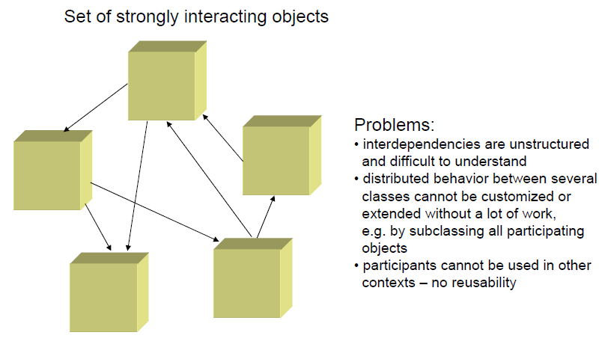
Example

Slide 29
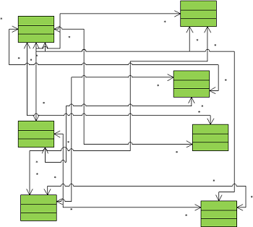
Example without mediator

Slide 30
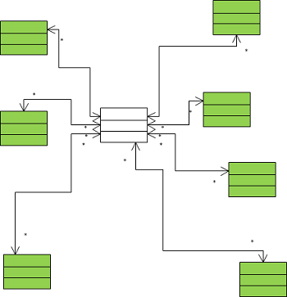
Example with mediator

Slide 31
Encapsulate what varies?

Slide 32
What varies? Interconnections
This design promotes loose coupling by keeping objects from referring to each other explicitly.
It also lets you vary their interaction independently.

Slide 33
Mediator Pattern
The Mediator Pattern allows you to “define an object that encapsulates how a set of
objects interact. ”.

Slide 34
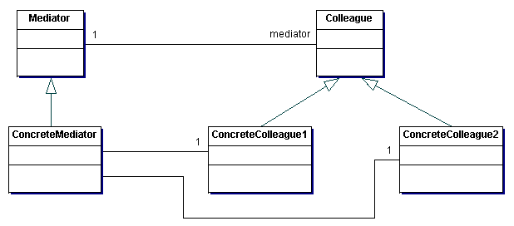
Class Diagram

Slide 35
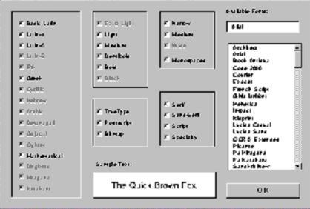
Example

Slide 36
Code 1 of 2
abstract class Mediator{
public abstract void colleagueChanged(Colleague c);
}
abstract class Colleague{
private Mediator myMediator;
public void changed(){
myMediator.colleagueChanged(this);
}
}
class ListBox extends Colleague{
public void display(){
//..drawing routines
}
public void mouseClick(int x, int y){
//ListBox obj does sth…
}
}

Slide 37
Code 2 of 2
Mediator Object
class FontDialogBox extends Mediator{
private Button ok; private List fontList; private TextField fontName;
private CheckBox latino; private CheckBOx latin2; //...more
public FontDialogBOx(){
fontList = new ListBox(this); fontName = new TextField(this); //...
}
public void display(){
fontList.display();
fontName.display(); //...
}
public void colleagueChanged(Colleague c){
if( c==fontList)
//font_list does sth…
else if(c==fontName)
//fontName does sth.
else if……
}
}
}
Declare Colleague
Objects
Manipulate colleague
Objects

Slide 38
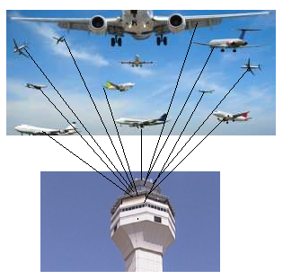
Example

Slide 39
Code
public interface Command {
void land();
}
public class Runway implements Command {
private IATCMediator atcMediator;
public Runway(IATCMediator atcMediator) {
this.atcMediator = atcMediator;
atcMediator.setLandingStatus(true);
}
@Override
public void land() {
System.out.println("Landing permission granted...");
atcMediator.setLandingStatus(true);
}
}
public class Flight implements Command {
private IATCMediator atcMediator;
public Flight(IATCMediator atcMediator) {
this.atcMediator = atcMediator;
}
public void land() {
if (atcMediator.isLandingOk()) {
System.out.println("Landing done....");
atcMediator.setLandingStatus(true);
} else
System.out.println("Will wait to land....");
}
public void getReady() {
System.out.println("Getting ready...");
}
}
public interface IATCMediator {
public void registerRunway(Runway runway);
public void registerFlight(Flight flight);
public boolean isLandingOk();
public void setLandingStatus(boolean status);
}
public class ATCMediator implements IATCMediator {
private Flight flight;
private Runway runway;
public boolean land;
public void registerRunway(Runway runway) {
this.runway = runway;
}
public void registerFlight(Flight flight) {
this.flight = flight;
}
public boolean isLandingOk() {
return land;
}
@Override
public void setLandingStatus(boolean status) {
land = status;
}
}
public class MediatorDesignPattern {
public static void main(String args[]) {
IATCMediator atcMediator = new ATCMediator();
Flight sparrow101 = new Flight(atcMediator);
Runway mainRunway = new Runway(atcMediator);
atcMediator.registerFlight(sparrow101);
atcMediator.registerRunway(mainRunway);
sparrow101.getReady();
mainRunway.land();
sparrow101.land();
}
}

